Slide 1
MRx Provider Portal Navigation

Slide 2
To log in, the user inputs their Username and Password, then clicks Sign In.

Slide 3
Get an Authorization

Slide 4
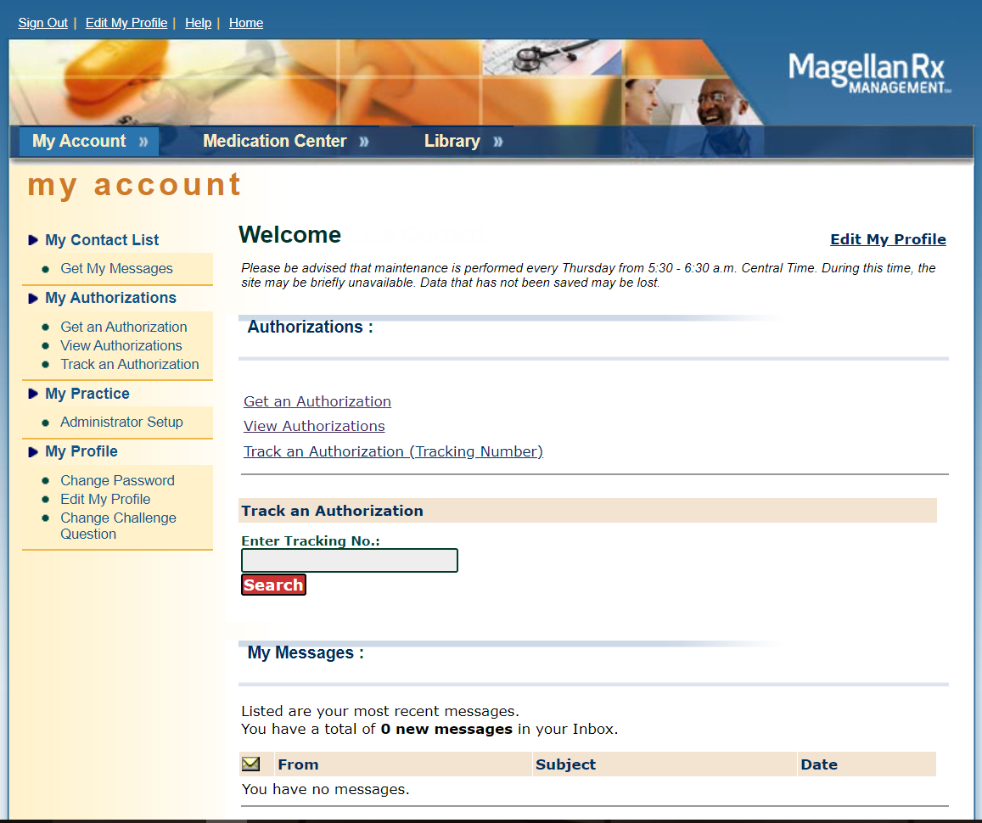
The user clicks on Get an Authorization to begin the prior authorization process.

Slide 5
The phone and fax numbers are required in order to continue.

Slide 6
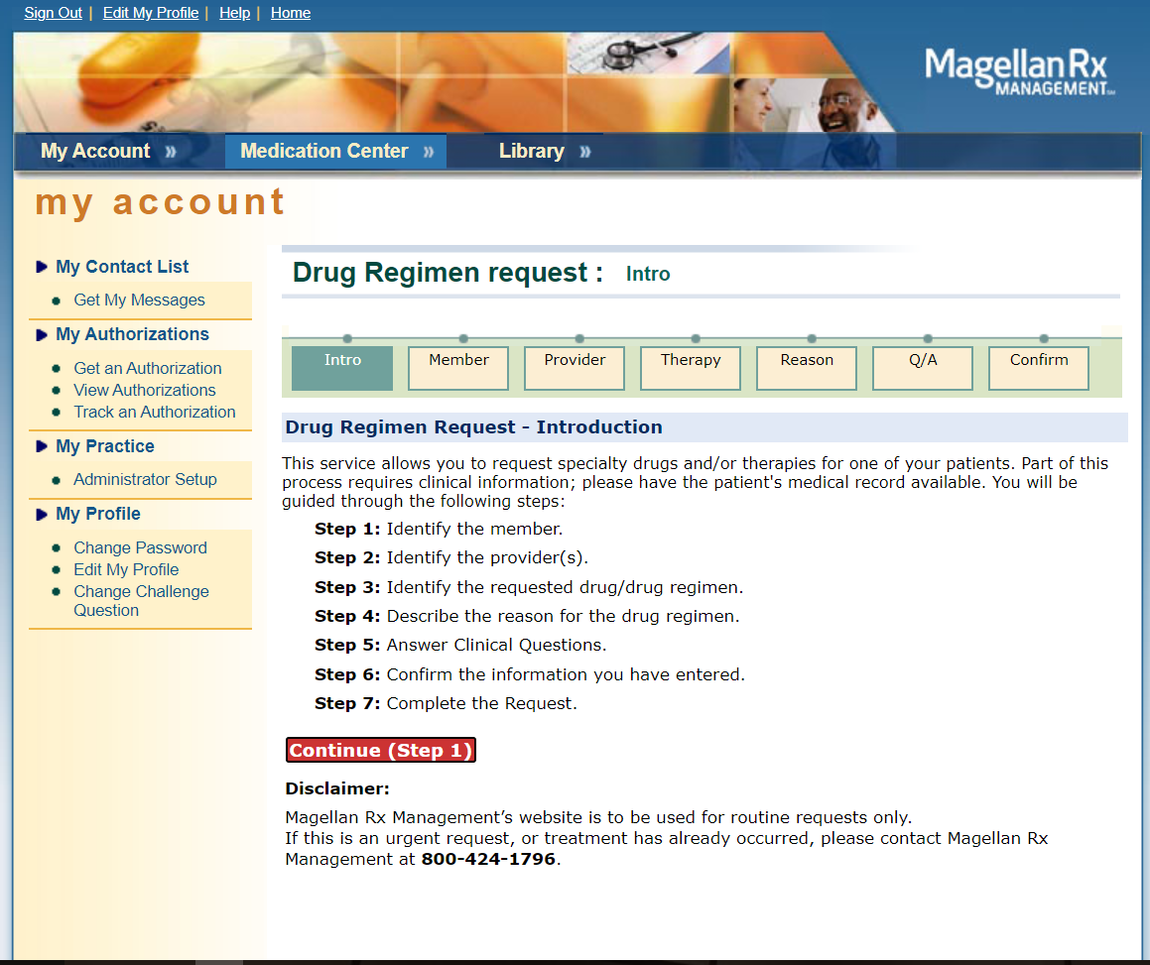
These are the steps the requestor will proceed through in order to request an authorization. The disclaimer at the bottom alerts the user that the portal is to be used for routine requests only.

Slide 7
The requestor inputs the member last name, first name, date of birth, and selects the health plan from the dropdown.

Slide 8
The member is confirmed, then the user selects their group/facility from the dropdown.
They are also able to indicate an alternative servicing provider.

Slide 9
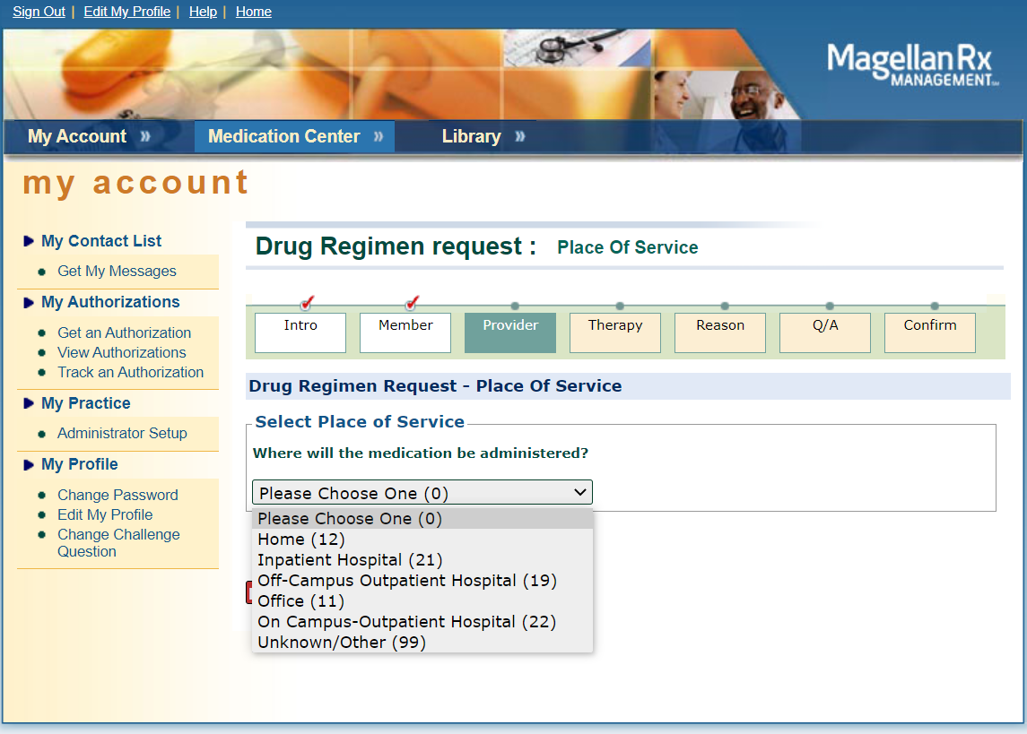
Place of Service is selected.

Slide 10
The drug regimen may be searched by brand name, generic name or procedure code and clicking the corresponding Search button.

Slide 11
The portal verifies if the drug requires clinical review. The user clicks on the drug name to proceed.

Slide 12
Multiple drugs may be requested simultaneously.

Slide 13
The user may search for the ICD10 by clicking the magnifying glass and activating the search engine.
If they have an anticipated date of treatment, they select ‘yes’ from the dropdown and select the date on the calendar. (This must be the present date or a future date.)

Slide 14
The clinical questions specific to the selected drug begin.

Slide 17
The responses are tracked and displayed for the user as they go through the algorithm.

Slide 18
The recommended dosing screen is displayed for the requestor for certain drugs. If they reject the suggested dose displayed, they will then be required to indicate the requested dose/frequency.

Slide 19
The requestor has the ability to upload clinical support documents.
The submitter verifies all of the information before clicking the submit button.

Slide 20
The requestor has obtained an approval.
If the request required additional review by Magellan Rx and/or additional information from the ordering provider, the requestor would see a pended status and would be provided with a tracking number. Please see next slide.

Slide 21
Pended Status example.

Slide 22
View Authorizations

Slide 23
MRx Portal Users may view all authorizations to which their account Tax ID is linked (rendering or ordering provider record).
User may do specific searches (1-4), or view all authorizations in the View All Section:
-View summary shows 10 at a time on the screen and the user may scroll through all auths under TIN.
-Create report creates a PDF file of all auths under TIN.
-Download electronic file creates an excel file of all auths under TIN.

Slide 24
Click on the Authorization Number to view the details.

Slide 25
Print this page by clicking the print button at the bottom.
View determination letter by clicking View Letter.

